Slide 1

HOUSING IN SG
Ng Wee Herng (2214296)

Slide 2

OBJECTIVE
Factors contributing to the most popular resale flat types in Singapore from 2011-2021

Slide 3

DATASET ON RESOLD HOUSES
DATA FIELDS
Month, Year → Date of sale
Flat Type, Block, Street, Address, Storey, Area, Flat Model
→ Information on flat
Lease Start/Lease Remaining → information of lease of unit
Prices of unit → with inflation, per sqm with inflation, buying price and leasing price
Bala Lease % → based on Bala’s Curve
Year GNI → Gross National Index (all Singaporeans)

Slide 4
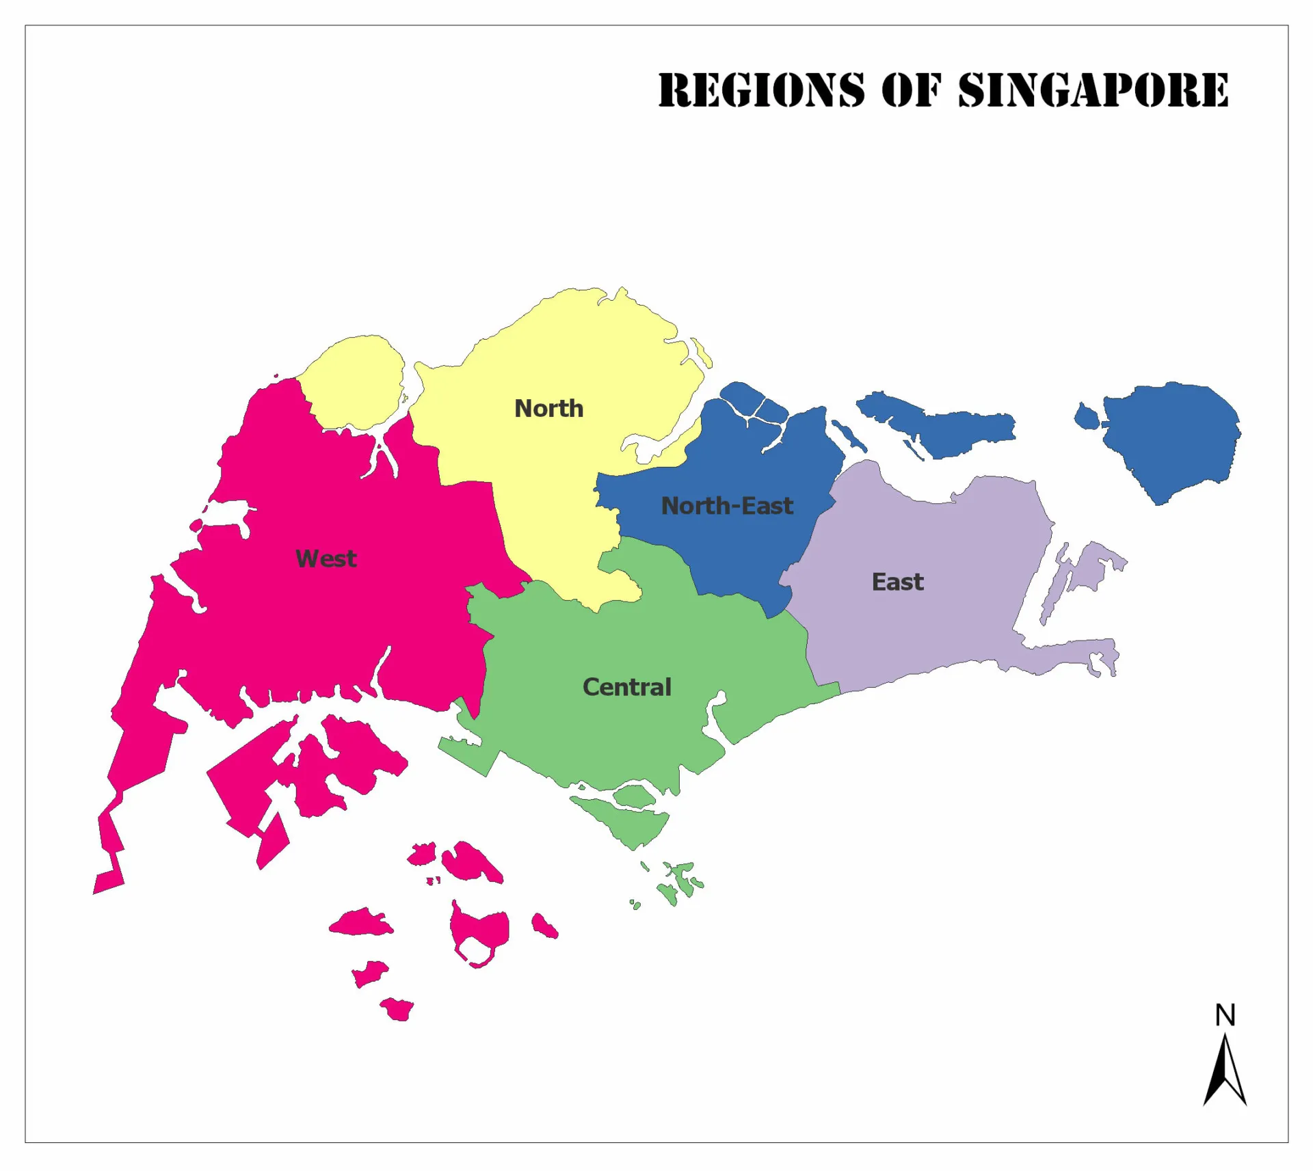
CLEANSING AND WRANGLING DATA
Removing duplicates with Excel feature → duplicates found
Removed columns that were not useful to me
town_dummy, block, address
All prices without considering inflation (cpi)
Removed any rows that was not from 2011 – 2021
Added a group in Tableau, grouping towns by region
Further grouped storey range into 5 main ranges for easier understanding
https://www.mappr.co/counties/regions-of-singapore/

Slide 5
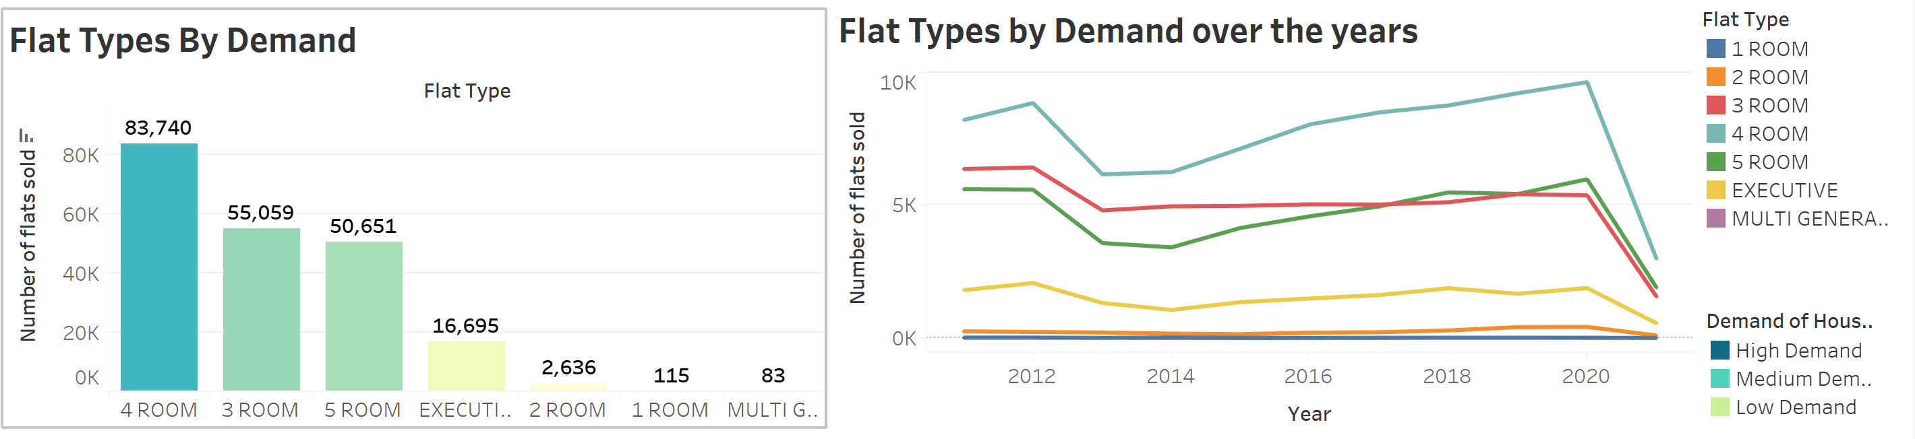

INSIGHTS
The top 3 most popular flat types are 4 room, 3 room and 5 room flats
From 2011-2021, the demand for the other flat types has always been low
Demand for 4 room flats are rising the most, while demand for 3 rooms are stable. Demand for 5 room flats have been increasing, surpassing demand for 3 rooms in 2017.
Due to Singaporeans wanting bigger living space
https://www.propertyguru.com.sg/property-management-news/2021/12/202914/singapore-buyers-prefer-homes-with-more-living-space

Slide 6
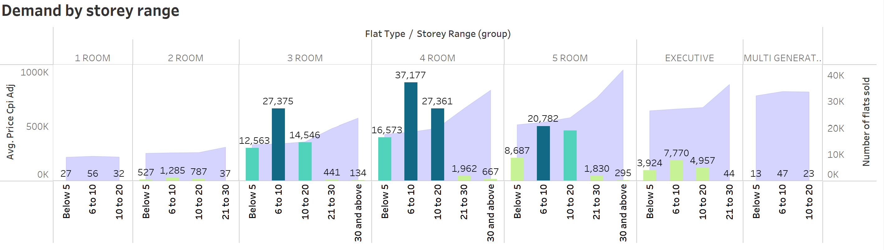
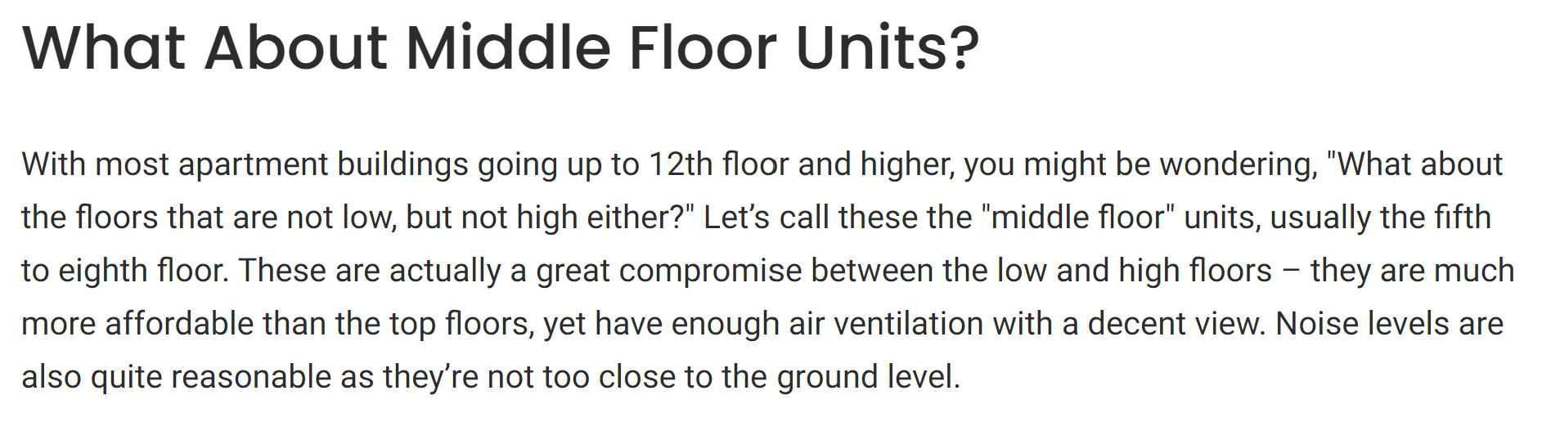
INSIGHTS
For all flat types, highest demand is in the 6 to 10 storey range, with 10 to 20 right behind
Stories higher than 20 are lower in demand due to its price, which as seen in the area chart skyrockets, especially in 5 room flats, where the price about doubles
High storey flats → Less prone to pests, natural wind ventilation
Low storey flats → Convenient, cheaper
Middle floor units (6-20) are the sweet spot among buyers
https://www.propertyguru.com.sg/property-guides/high-floor-vs-low-floor-unit-which-is-better-45449

Slide 7
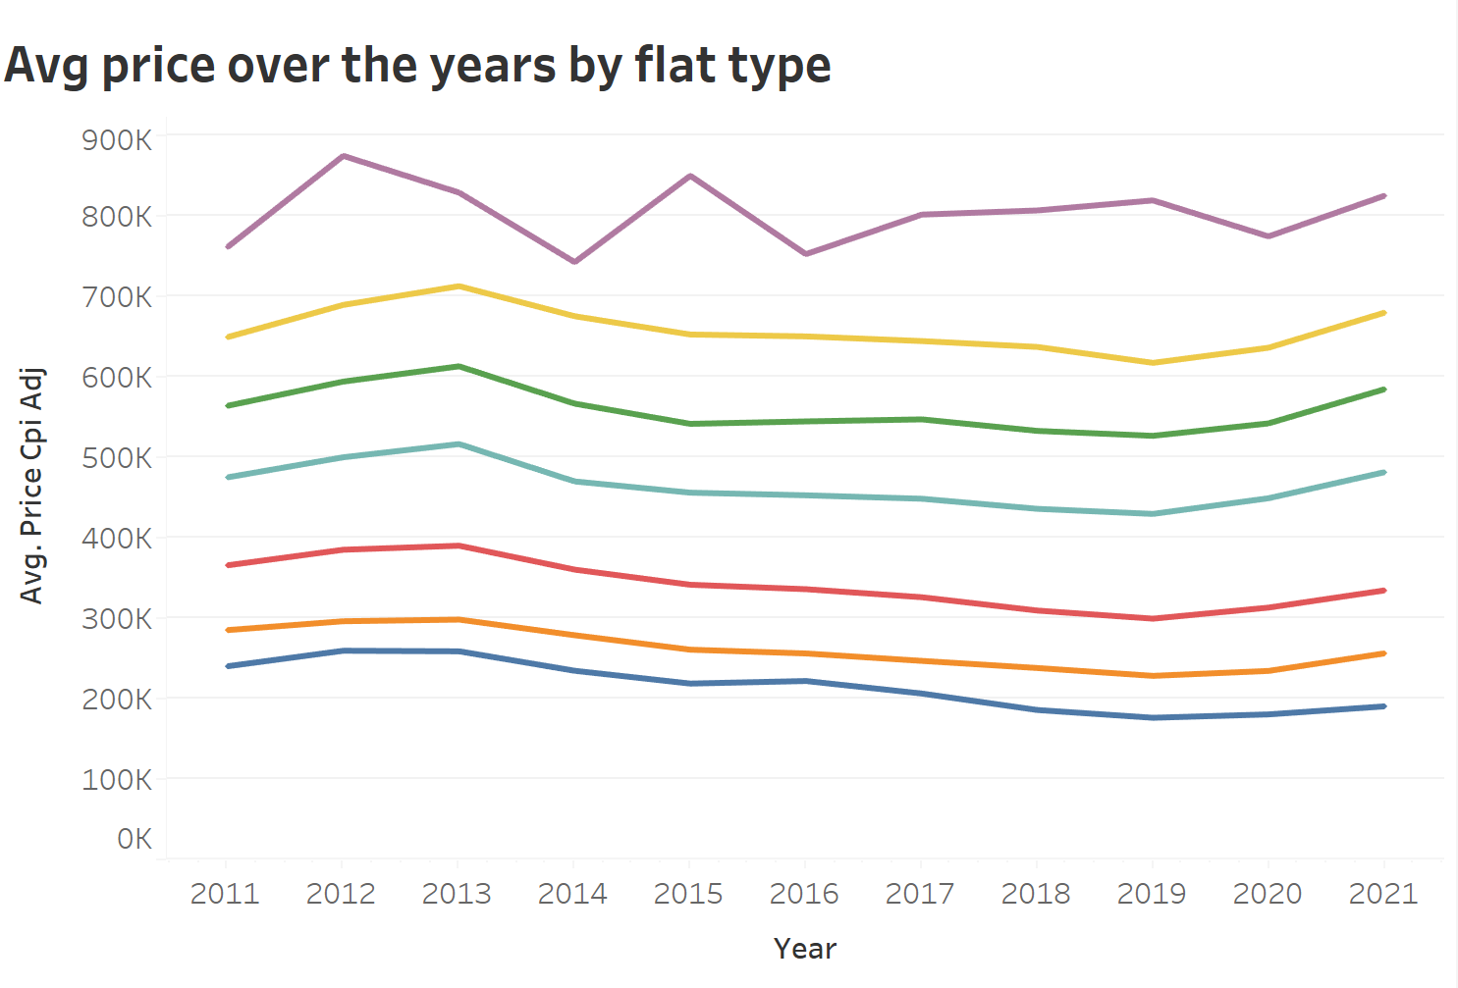
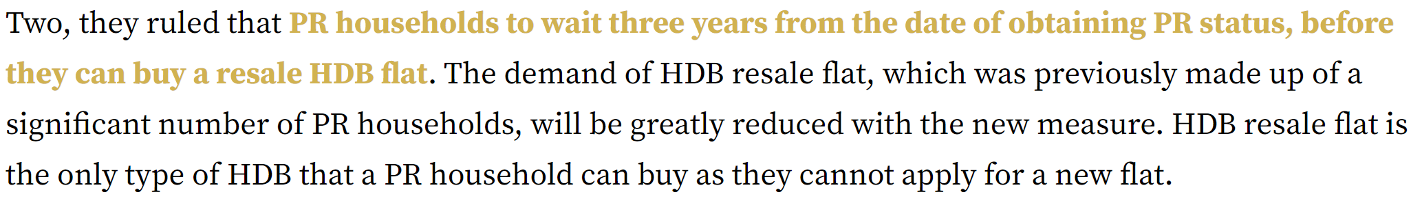
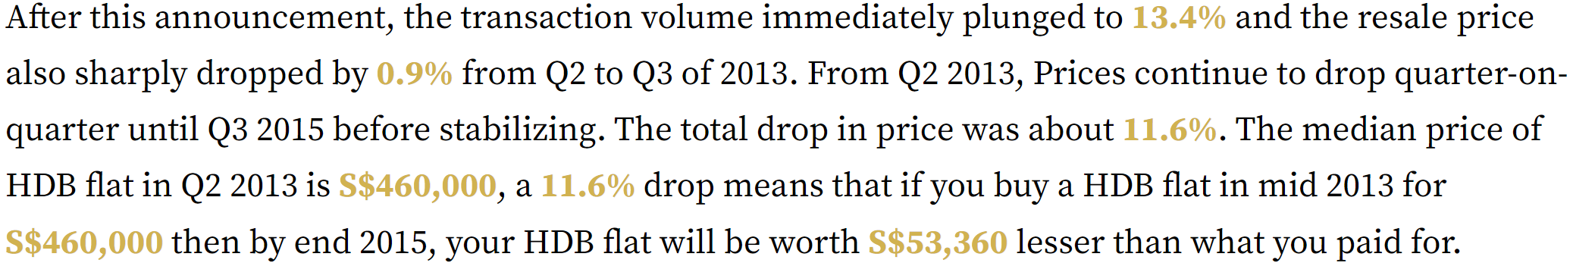
INSIGHTS
From the donut chart, we can see that North-East region has generated the most revenue over the 10 years
From 2011 to 2015, West generated the most revenue and North-East took over after
Average price of flats have been pretty stable over the 10 years, with a drop in 2013 due to measures the government implemented
https://www.homequarters.com.sg/2020/06/03/2013-the-fateful-year-that-caused-hdb-prices-to-plunge-10/

Slide 8
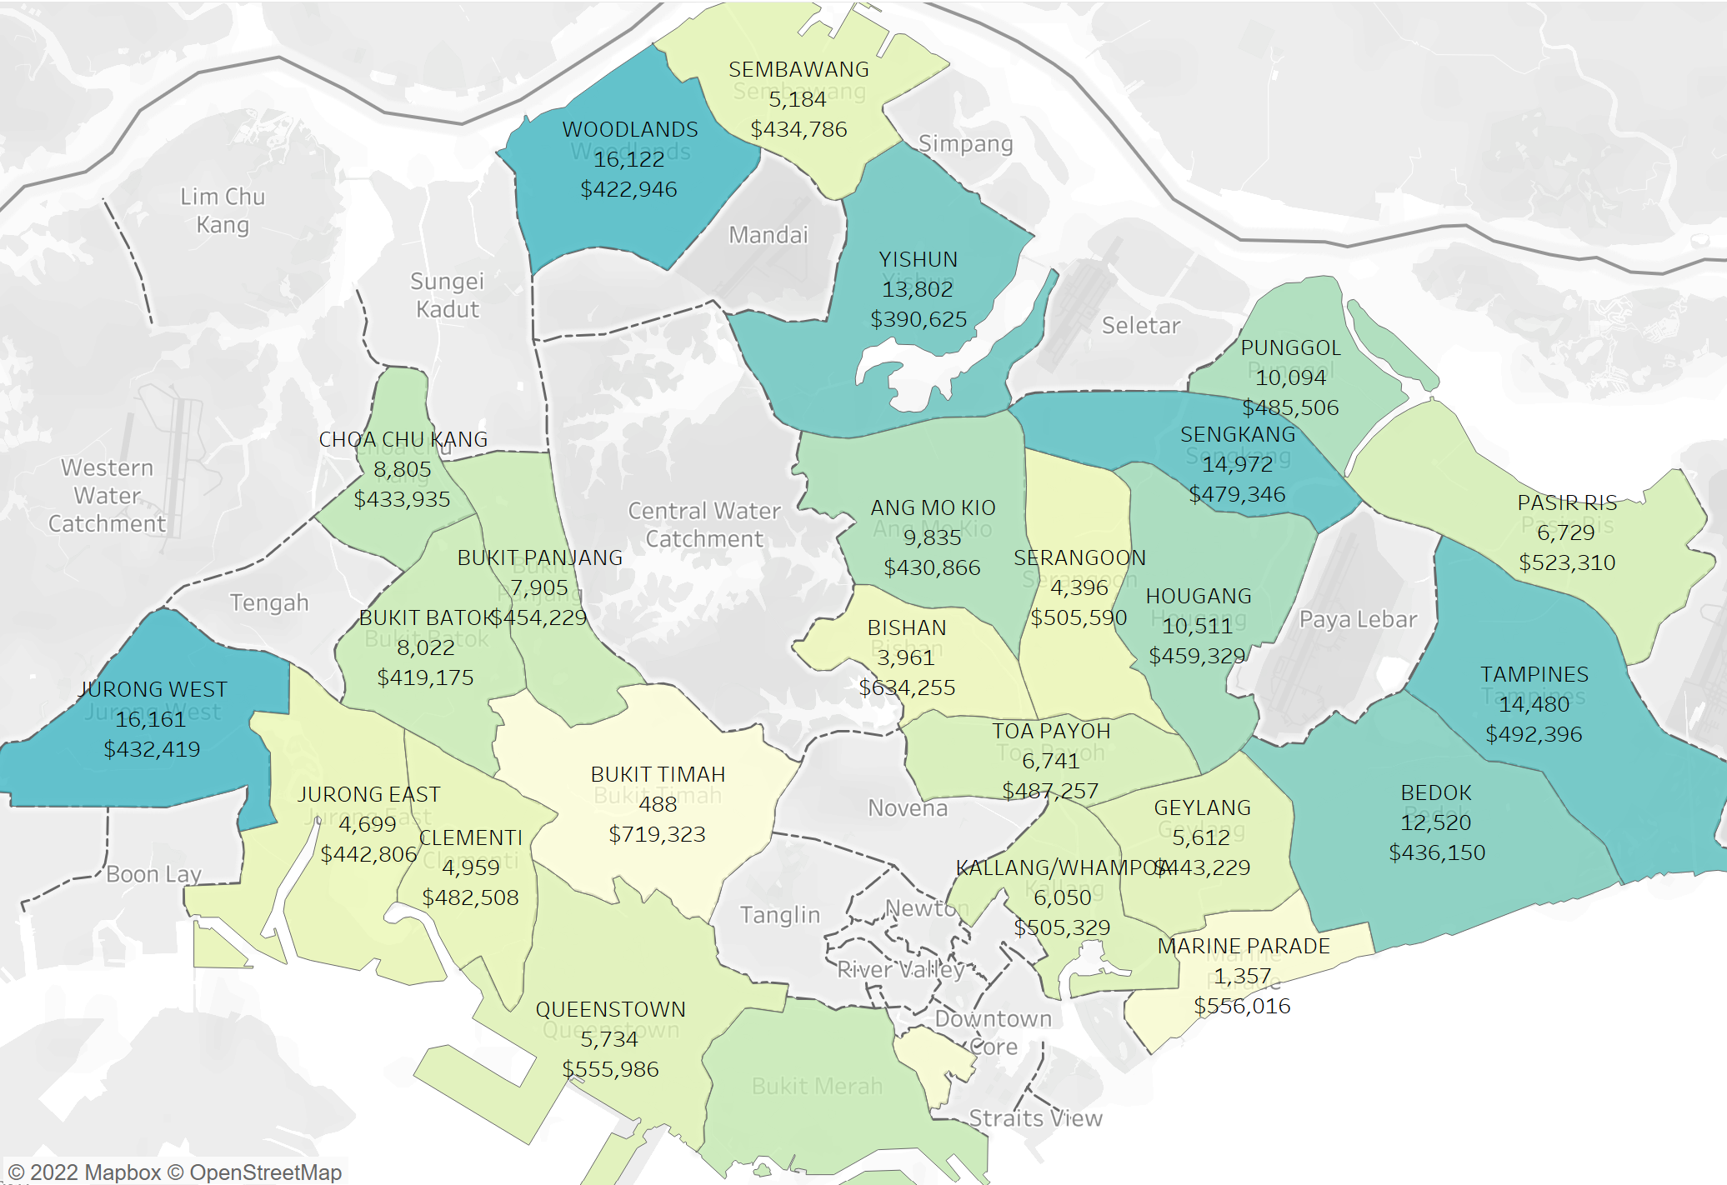
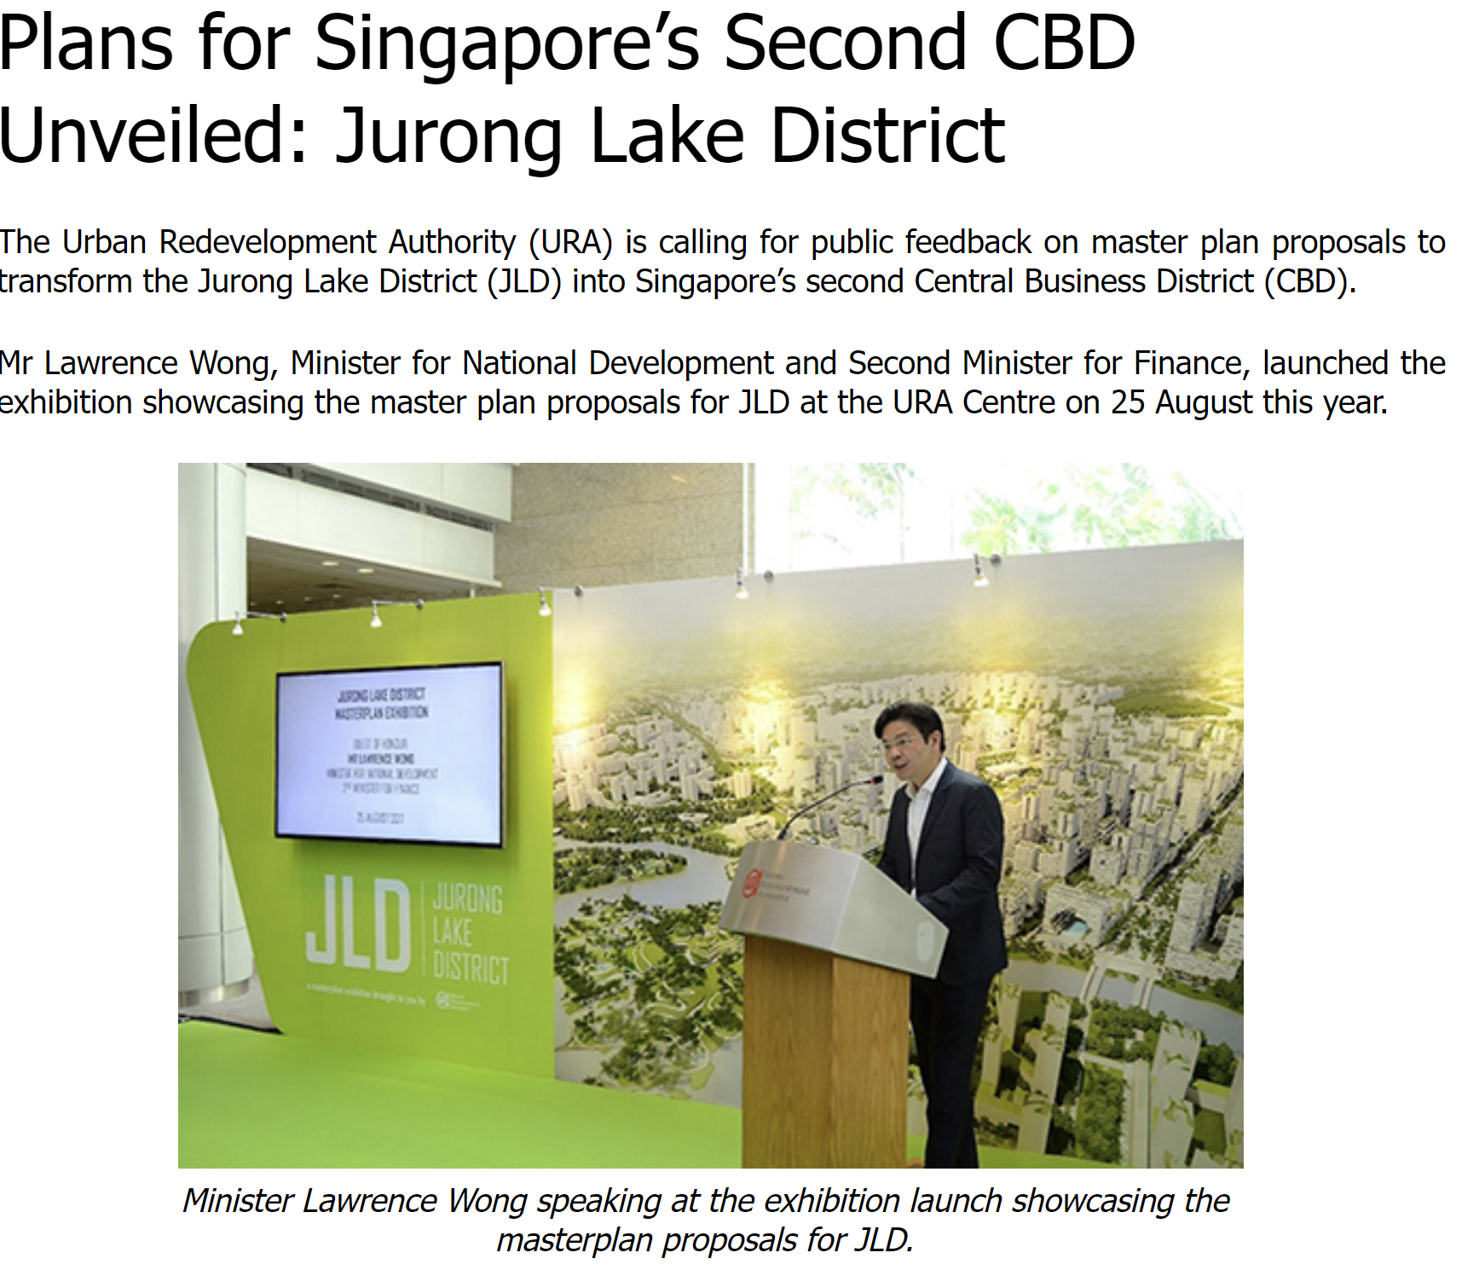
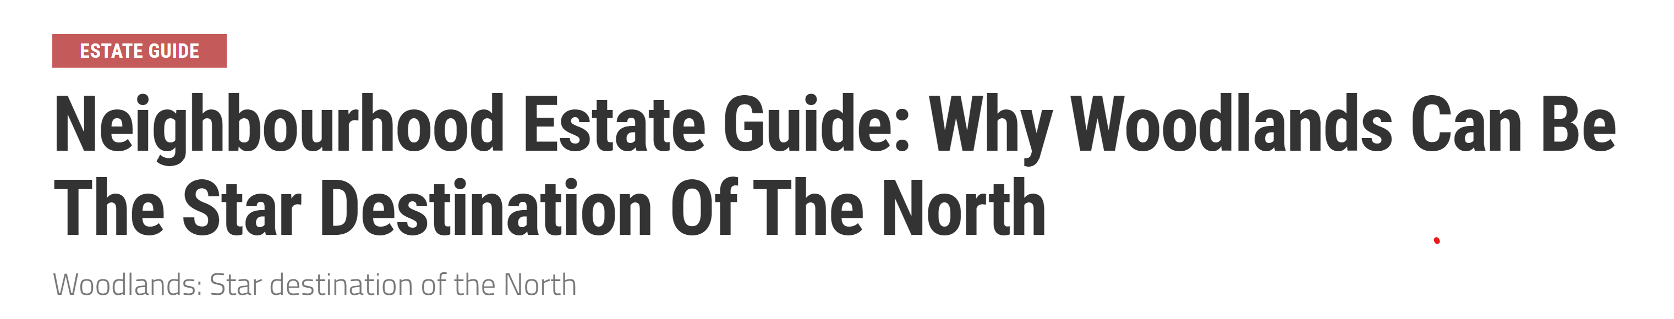
INSIGHTS
From filed map, towns with highest demand are Woodlands and Jurong West
Jurong West → Jurong Lake District will be transformed into second Central Business District
Woodlands → Affordable, set to undergo a major transformation with the development of the Woodlands Regional Centre, turning it into a key commercial hub of the North.
Both are self-contained, with many amenities
https://dollarsandsense.sg/neighbourhood-estate-guide-woodlands-can-star-destination-north/
https://www.mnd.gov.sg/mndlink/2017/Nov-Dec/plans-for-singapores-second-cbd-unveiled.htm

Slide 9


RECOMMENDATION
HDB can consider building new 4 and 5 room flats in areas like Jurong West and Woodlands to meet the demands of such flat types
This will help smoothen the demand in resale flats and prevent the resale prices from shooting up.
This can then align with HDB’s mission
https://www.hdb.gov.sg/cs/infoweb/about-us/vision-mission-and-values/vision-and-mission

Slide 10

LEARNING POINTS
TABLEAU
HOUSING
Tableau techniques
Understand data visualisation better
Know more about how housing works in Singapore

